Slide 1

Bayesian Route Planning in a Dynamic Environment
Tiffany Hwu
Notes:
Statistical model for bayesian route planning
Starting point to implement on LeCarl in Aldrich Park

Slide 2
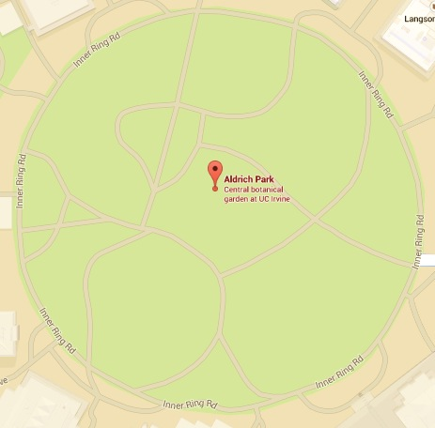




Search and Rescue Scenario
Notes:
Scenario-aldrich park has become a disaster zone, goal is to reach these locations of survivors and report back home with information about them
Assume robot is equipped with GPS
Environment is dynamic
-temporary roadblocks, fires, broken terrain

Slide 3
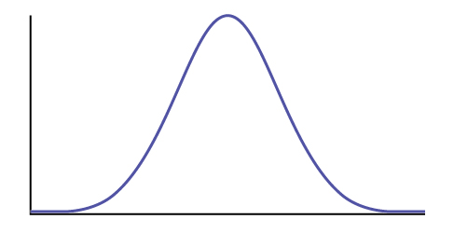

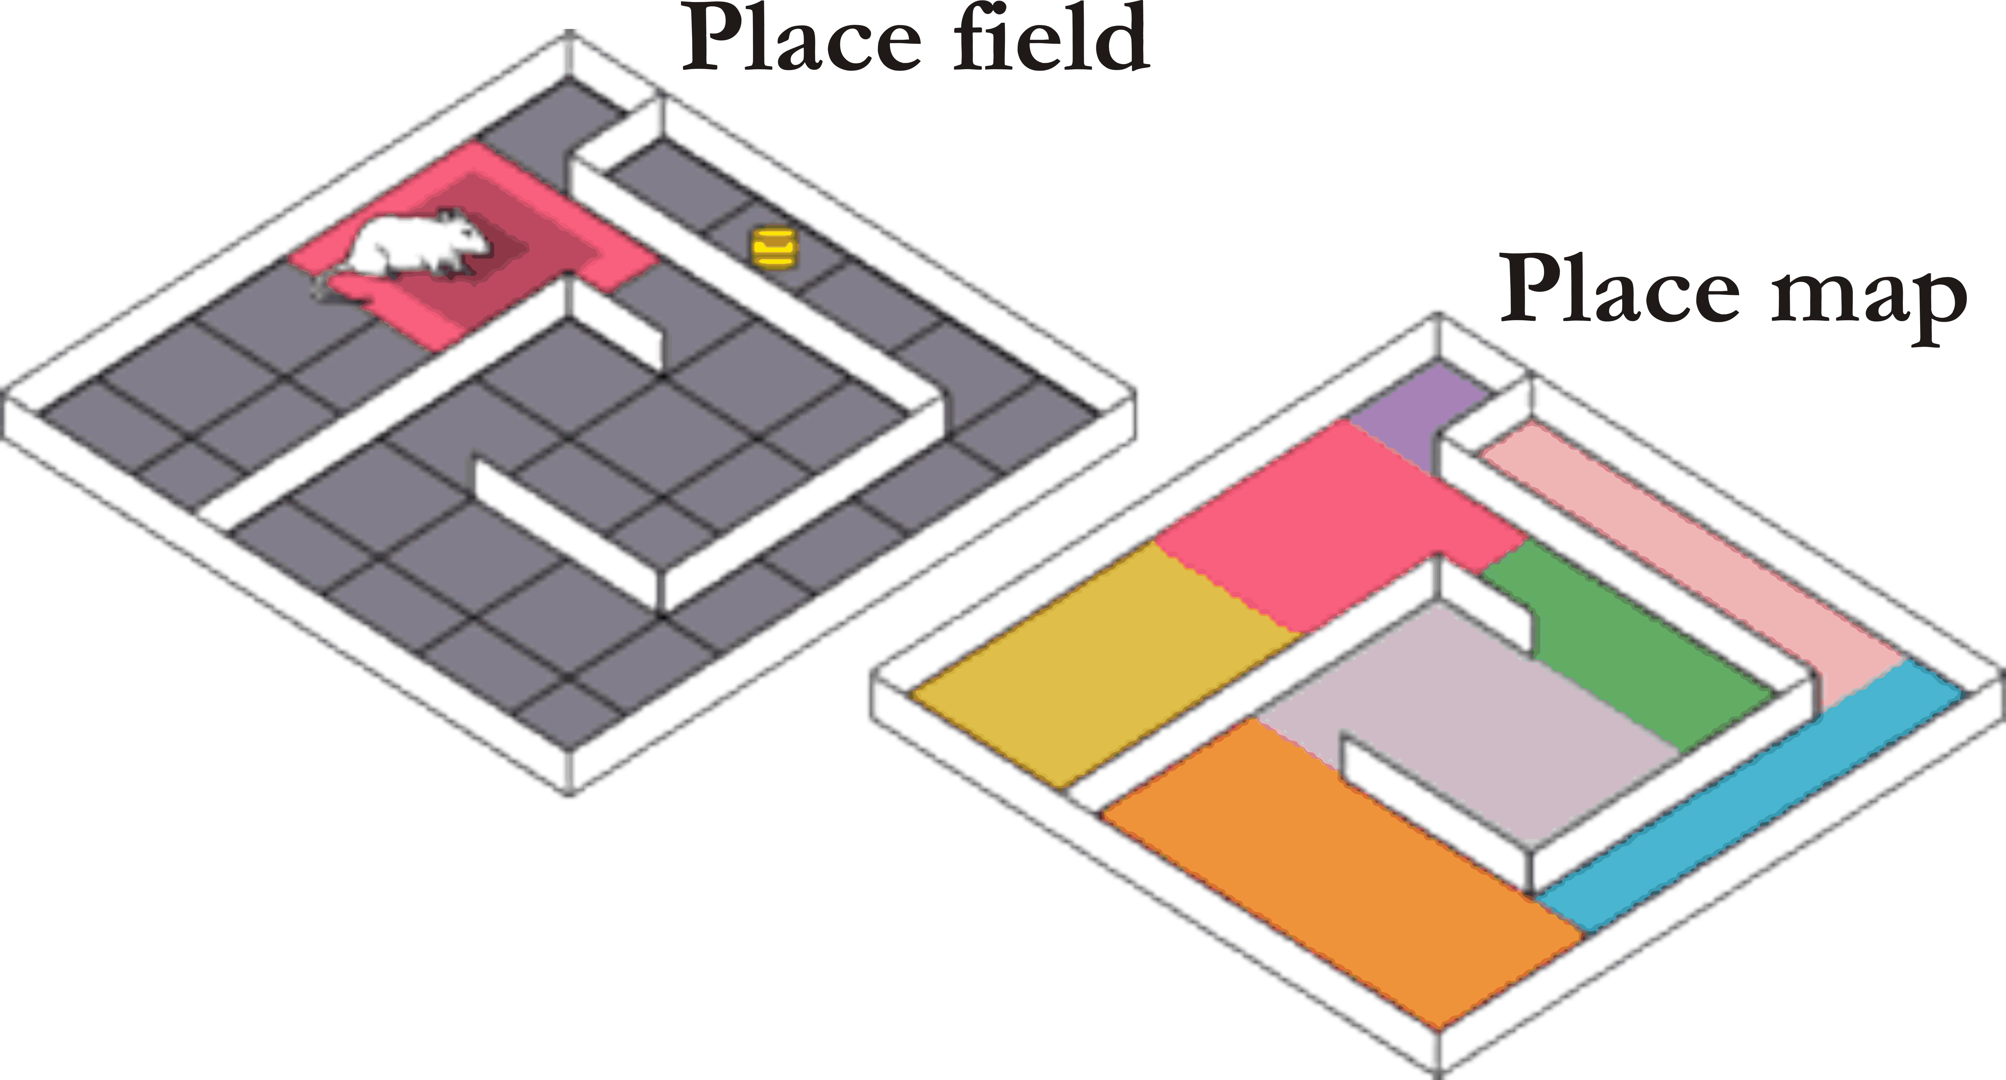
General Idea for Model
robotenomics.com
mercercognitivepsychology.pbworks.com
Notes:
Bayesian cognitive models
-brains form hypotheses about the world and use new sensory data to back them up
Cognitive map in hippocampus integrate sensory information about values and space

Slide 4
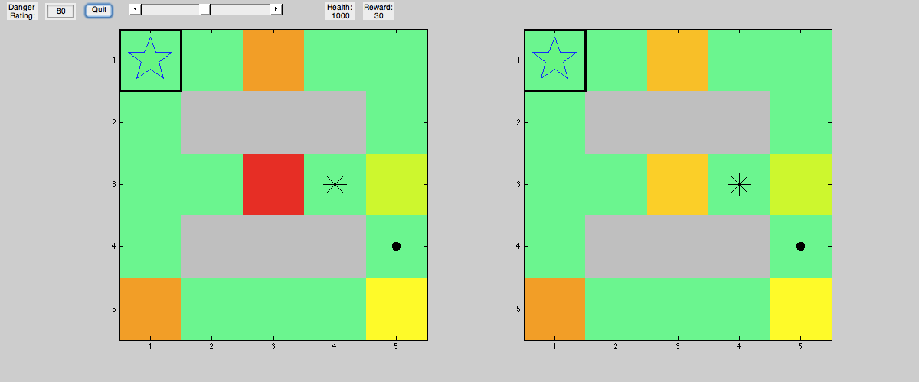
Matlab Demo

Slide 5
Experiment 1: Inferring Safety Levels of Different Regions
Set danger values of each valid square to 0
Loop:
1. Update danger beliefs about current square and neighbors
1. Calculate all routes to destination using depth first search
2. For each route, sum the danger values of each square 3. Rank routes by a weighted sum of danger and distance, pick the highest ranking route to take 1 step
4. If destination is reached, pick a new destination

Slide 6
Experiment 2: Adding Rewards Matlab Demo

Slide 7
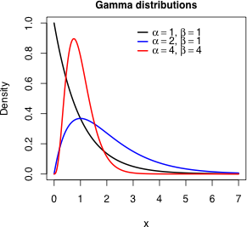
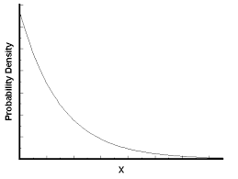
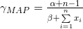
Experiment 2: Updating Reward Beliefs
Prior
Likelihood
Posterior
Posterior Hyperparameters
Maximum A Priori estimate
Notes:
Alpha is shape – represents mean, Beta is shape

Slide 8
Experiment 2: Exploration/Exploitation
Exploration is a value ranging (0,1) that affects 3 parts of the decision-making process:
The initial value of α in the belief. A highly explorative agent will have an α that affects the shape of the distribution such that the mean is very high. The agent thinks all foraging locations are very promising.
The safety net value of health that the agent maintains before deciding to head home
Picking a destination. A random number is chosen in the range (0,1). If it is less than the exploration value, the agent will pick a random foraging site to head towards rather than just picking a site it knows is good.

Slide 9
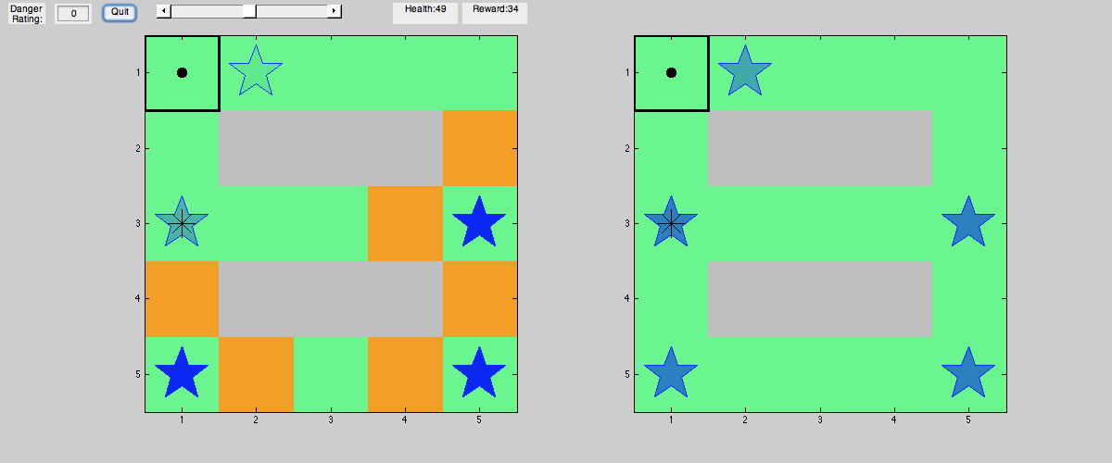
Map for Explorers

Slide 10
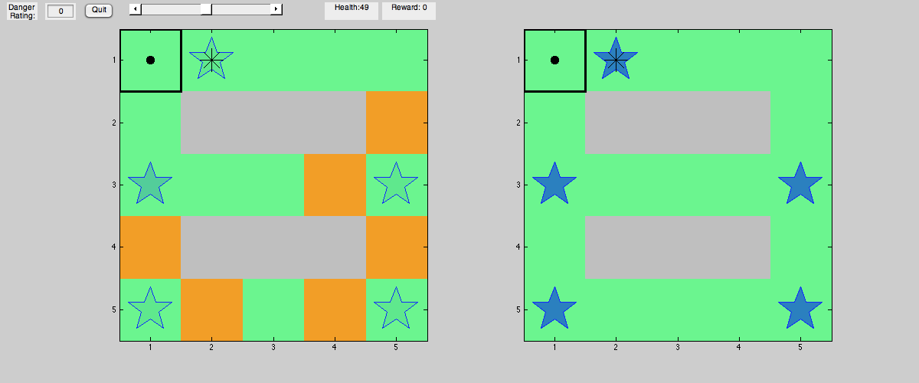
Map for Exploiters

Slide 11
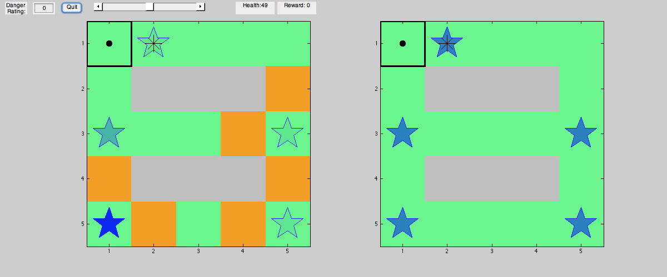
Map for Everyone

Slide 12
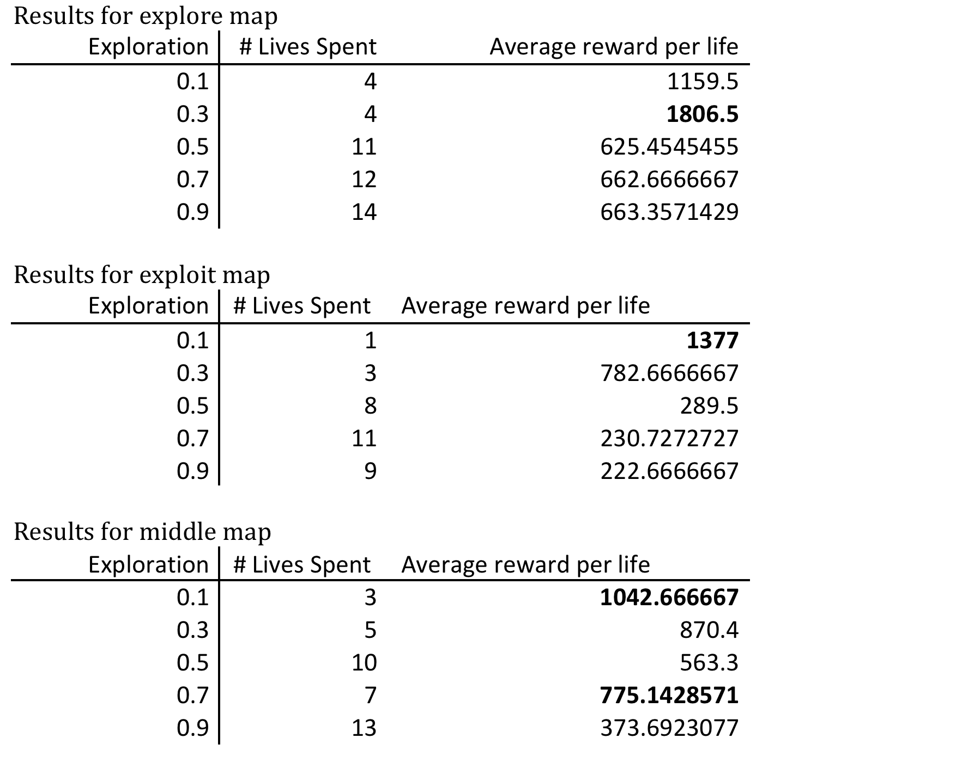
Results

Slide 13
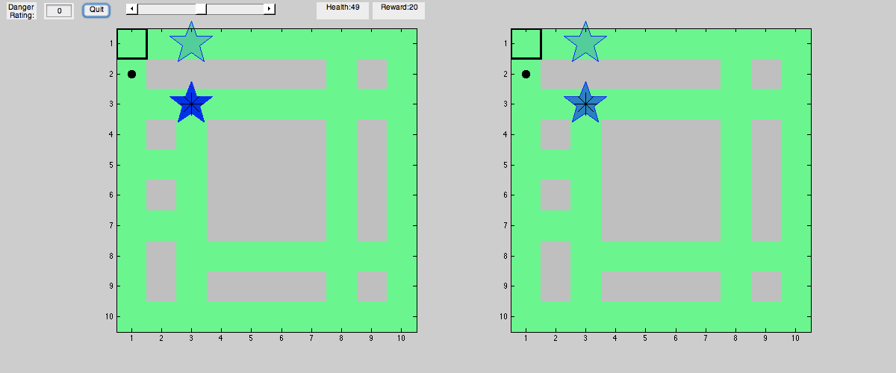
Conclusion and Future Directions
Test in real life
Discretization
Material for value judgments
Route computation infeasible for large graphs
Use heuristics

